Slide 1
LARGE TRICS SAM Survey
Westfield, Shepherd’s Bush
Marie Hancock
Notes:
Today, I’m going to talk about our largest TRICS survey to date, that we carried out earlier this year at the Westfields Shopping Centre in Shepherds Bush.

Slide 2
Outline
The Site
Survey Methodology
Results
Notes:
I’ll start with an outline of the site and why the survey was requested.
Then I’ll talk about how TRICS and ourselves adapted the standard TRICS methodology to make it more effocoent and practical fpr a site of this size and complexity.
Then I’ll discuss some of the events of the survey day and some results obtained.

Slide 3
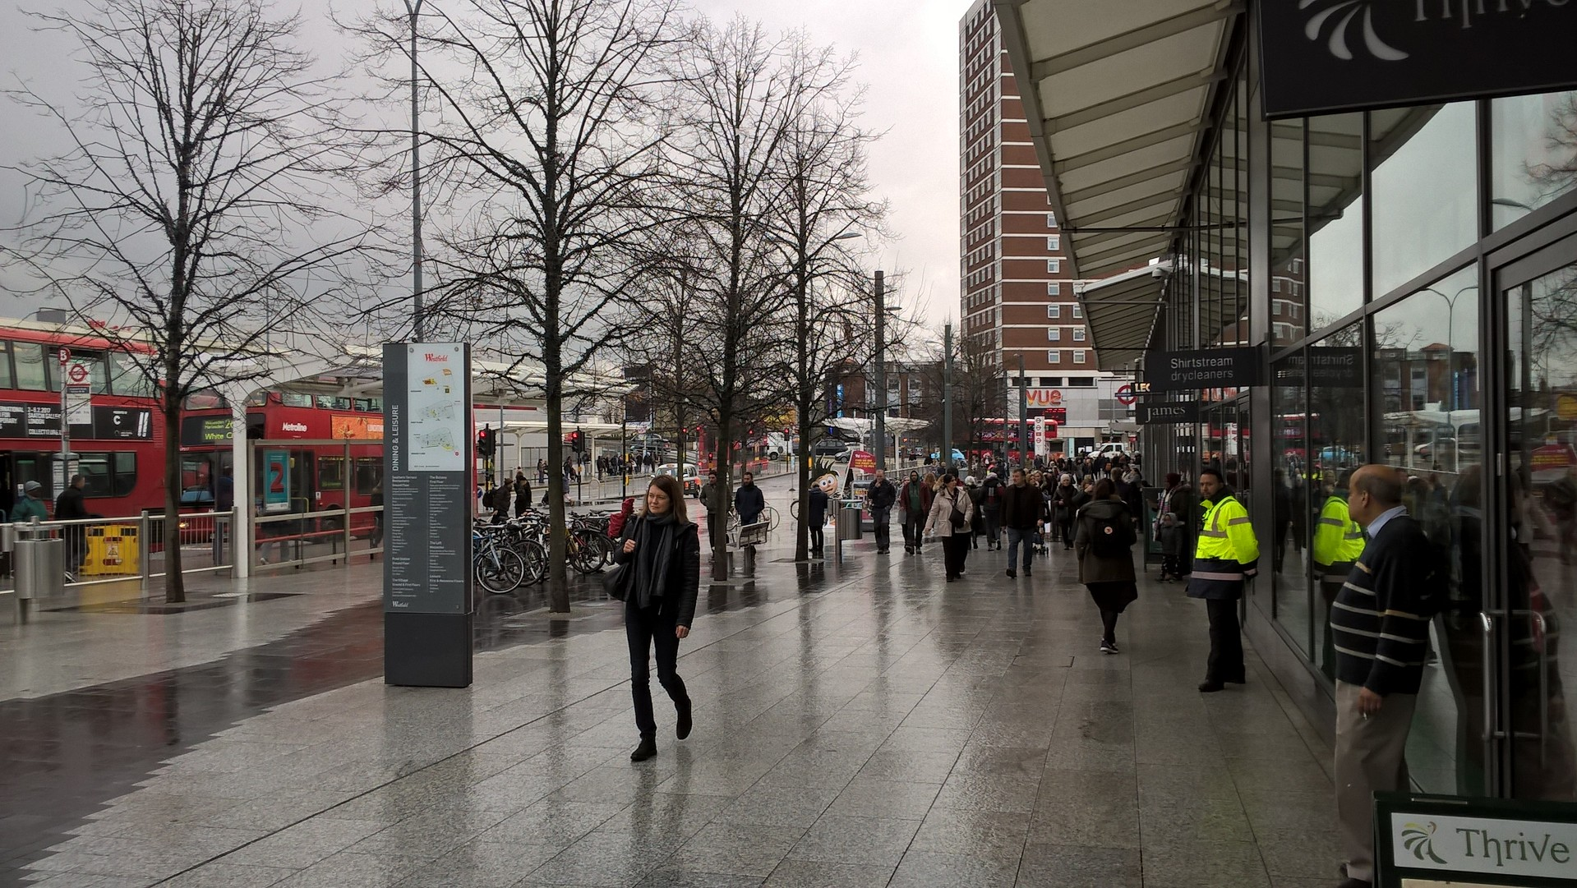
The Site
    Originally opened in 2008
    Site to be extended to include more retail and residential
    Travel Plan requirement
    Monitoring surveys
Notes:
Westfields is located in the borough of Hammersmith and Fulham at Shepherds Bush.
It opened in 2008. and is currently being expanded to provide more retail and residential ,
The TRICS survey is requirement of the Travel Plan.

Slide 4
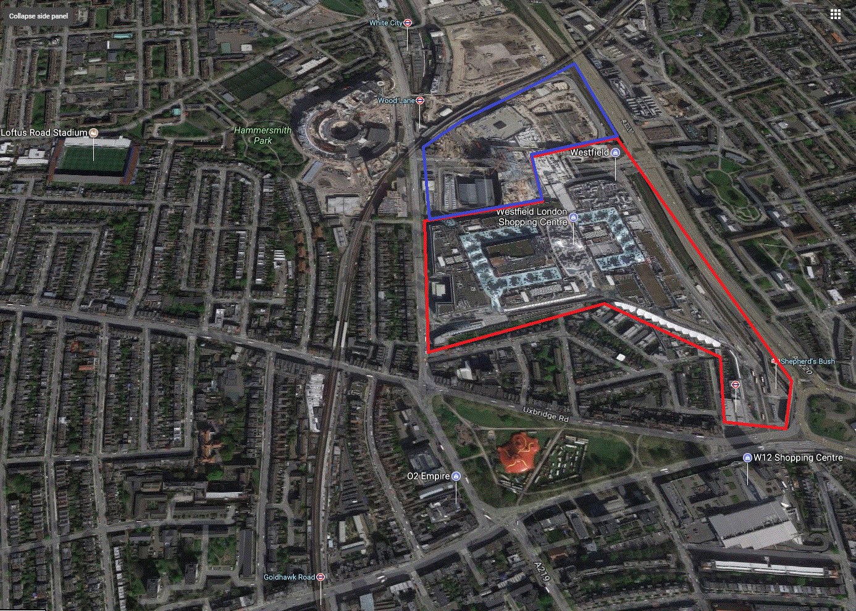
The site
Notes:
The site covers an area of 20 hectares ( 28 football pitches) and over two main floors/. The red boundary is the existing site with the blue boundary being the extension to the site.

Slide 5
Some details
300+ units within site being a mixture of retail, food and leisure
3 delivery yards
12,000 staff
Other cinemas and shopping centre in local area
Football ground within walking distance
Open 10am to 10pm
Notes:
There are over 300 units including a cinema, restaurant, a Waitrose.
In addition there are retail and leisure outlets in the local area as well as QPR’s home ground in walking distance.
12,000 staff work at the site.
The opening hours are 10-10, although there are some units opend before and sfter these times.

Slide 6
Some details
3 tube lines (Circle, Central and Hammersmith and City Lines)
Over 35 tube trains an hour
1 Overground and National Rail station
17 local bus routes
100+ buses an hour
4,500 car parking spaces within site
Notes:
To get to the site, customers and staff have a choice of four underground stations with access to the Central line, Circle line and Hammersmith and city lines. There are some 35 trains an hour.
An Underground and mainline rail station at Shepherds Bush. There are also 17 bus routes providing over 100 buses an hour.
There are also 4,500 carparking spaces with a daily tariff of £8.00 or hourly of £2.90.

Slide 7
Standard Assessment Methodology (SAM)
Monitor all accesses to a site and record the mode of travel of all people entering and leaving the site.
Survey hours are generally one hour before the site opens to an hour after it closes.
Collection of Background information : includes details of staff, floor area of site etc.
Analysis of Travel Plan.
Collection of parking details.
Notes:
The standard TRIVS methodology requires the surveillance of activity at each entry point to a site. This normally includes all access points, both busy and lightly used with the objective of collecting the mode of travel of all people entering a site and of all people leaving a site. For busier access points more than one enumerator will be required.

Slide 8
Standard Assessment Methodology (SAM) – Westfields
22 distinct accesses into the site
  Carpark accesses
  Three service yards
  Four main pedestrians accesses (one really big!)
  Numerous staff accesses
  Numerous accesses via store fronts
  Around 30 enumerating staff at any time
Long survey day (7am to 11pm)
Notes:
The Westfields site has 22 distinct accesses and if specified, as per the standard methodology would have required 30 staff working at any time, plus more required for breaks, plus even more required due to the length of the survey (16 hours).

Slide 9
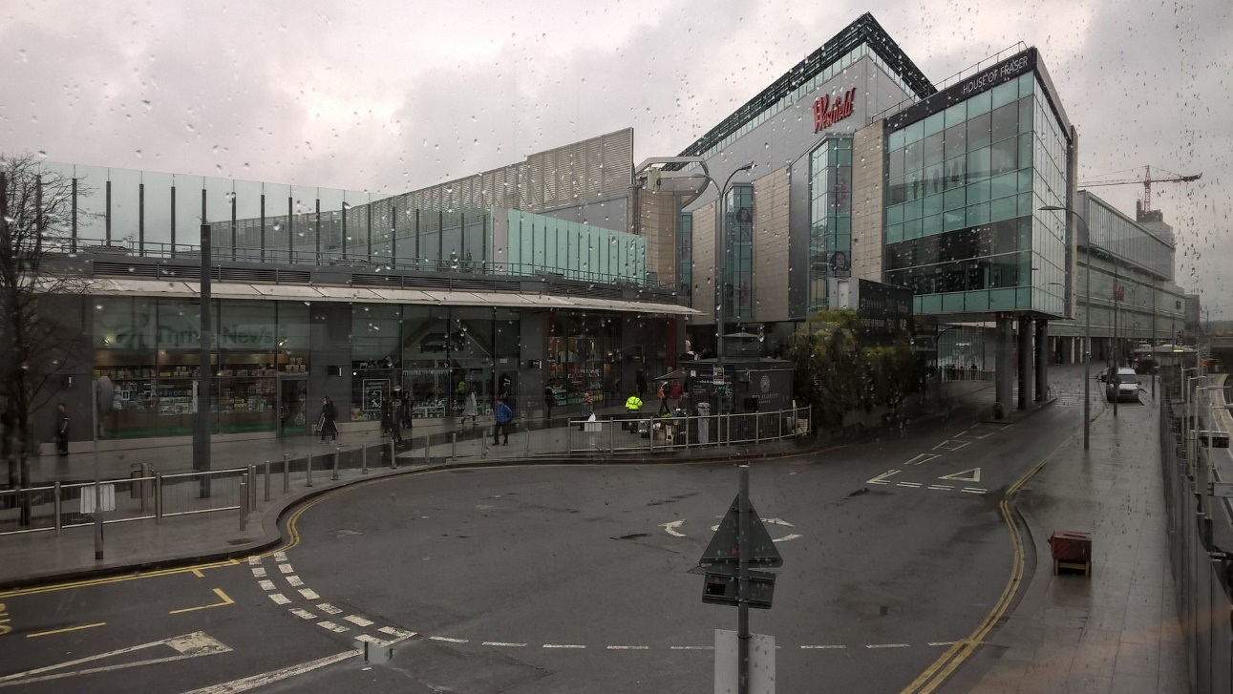
The approach ????
Notes:
The sheer number of enumerators was simply not a practical proposistion. More importantly, given the expected volumes of movements, it would not have been possible to obtain a full sample of interviews, that is, interview everyone. The response rate in London is also lower than the rest of the UK due to various factors including language.

Slide 10
The approach
Concentrated resources at the main accesses
Surveys on two Saturdays
  One Saturday for vehicles only
  One Saturday for people on foot
  Head Counts by video
Notes:
The first Saturday we monitored all vehicle movements at the site. This included the three delivery accesses, the taxi accesses and the customer carpark. The vehicle survey was carried out using enumerating staff and video surveillance.
The second Saturday we monitored the main pedestrian accesses and interviewed people to establish their mode of travel.

Slide 11
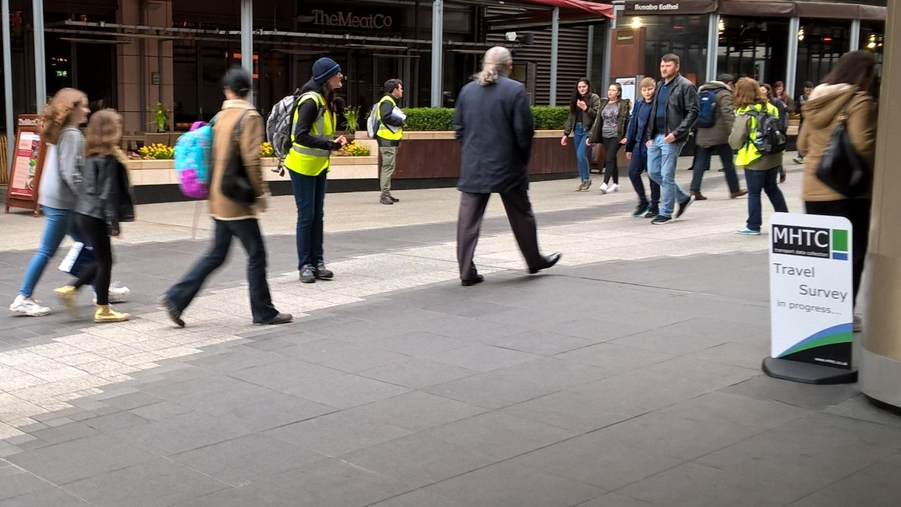
The survey days
The days were very long and very busy
78,000 trips to the site
20,000 people arrived by private car
19,000 by tube
150 deliveries

Slide 12
The survey days
At the busiest access, 37,000 people entered.
Five to six staff working at any time, as well as a video head count.
Notes:
This is an extract of one of the video cameras used to obtain the head count at this access. You will see that waves of people arrive as a tube or bus arrives.

Slide 13
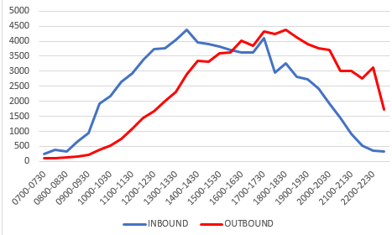
Some results
Notes:
This slide shows the volumes of people arriving through the day. The blue is the inbound flow, which increased gradual to an early afternoon peak of over 4,000 people as well as around 5pm. Outbound traffic peaked nearer to 6pm and as things started to settle down, we had a surge of staff leaving at 10pm.

Slide 14
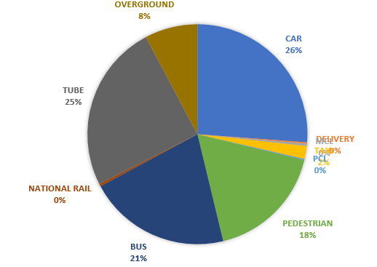
Some results
Notes:
This slide shows the modal split over the whole day. The three big modes are private car, around 26%, Tube, 25% and Bus at 21%.

Slide 15
Some results
100% observation rate for on-site vehicular traffic
Near 100% observation rate for people arriving on foot.
Interview rate of around 30% at the main accesses (nearly 18,000 interviews).

Slide 16
To finish
Data uploaded into TRICS using the new upload facility.
TRICS proved that it can cope technically with flows of 4 and 5 significant figures.
TRICS proved it can modify its methodology for efficiency and practicality for large surveys.
Notes:
The Westfields site has 22 distinct accesses and if specified, as per the standard methodology would have required 30 staff working at any time, plus more required for breaks, plus even more required due to the length of the survey (16 hours).

